Slide 1

Power point PRESENTATION
Presented by bizima Peace

Slide 2

content
Project Introduction
Methodology
Results
Recommendations
Future Work

Slide 3

PROBLEM DEFINITION & PLANNING
I. Sector : Tourism
II. Problem statement : Can we forecast the USA national park visitation based on historical data? III. Dataset Identification:
▪ Dataset Title: National Park Service ▪ Source Link: https://www.nps.gov/subjects/socialscience/visitor-use-statistics-dashboard.htm
▪ Number of Rows and Columns: 9 columns and a total of 4,778 rows
▪ Data Structure: Structured (CSV)
▪ Data Status: Requires Preprocessing

Slide 4

PROJECT Introduction
This project focuses on forecasting recreation visit numbers to U.S. National Parks using historical data from the National Park Service. The process includes data preprocessing, exploratory analysis, and training various machine learning models to determine the most accurate predictor. The top-performing model is then applied to generate predictions for future or unseen data.
This is further broken down and summarized in the following key points:
Goal: Predict U.S. National Park recreation visits using historical data.
Tools: Python (Jupyter Notebook) & Power BI
Deliverables: ML model, EDA, interactive dashboards
Real-world Impact: Informs staffing, inventory, and park operations.

Slide 5

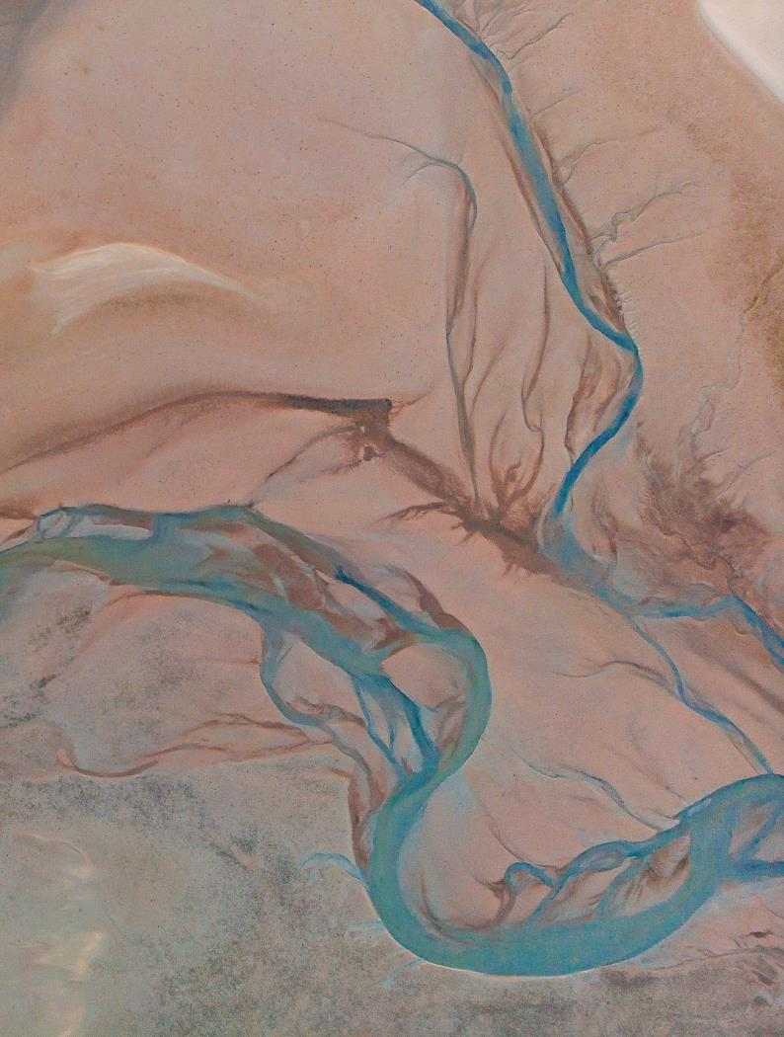
Methodology
Phase 1: Data Pre-processing and Exploratory Data Analysis (EDA)
Data Acquisition: The project began by loading the raw data from the National park service.csv file into a Jupyter Notebook using the pandas library.
Data Cleaning: This was a critical step to prepare the data for analysis and modeling. It involved:
Removing the initial two informational header rows.
Standardizing column names by converting them to lowercase and replacing spaces with underscores.
Removing any rows that were entirely empty.
Cleaning and converting the recreation_visits and recreation_hours columns from strings (which contained commas) to a numerical integer data type.
The cleaned data was then saved to a new CSV file, cleaned_nps_data.csv, for consistency.
Exploratory Data Analysis (EDA): The cleaned data was thoroughly examined to uncover key trends and patterns.
Python/Jupyter Notebook: Visualizations such as histograms, boxplots, and correlation heatmaps were generated to understand the distribution of variables, identify outliers, and see relationships between different columns.
ThePhoto by PhotoAuthor is licensed under CCYYSA.

Slide 6
Continuation
Phase 2: Predictive Modeling
Feature Engineering and Encoding: To prepare the data for the machine learning models, categorical features (park, park_type, region, state) were converted into a numerical format using a LabelEncoder.
Model Selection: Three different machine learning regression models were chosen to be trained and compared: a baseline Linear Regression, a powerful ensemble model called the Random Forest Regressor, and another robust ensemble model, the Gradient Boosting Regressor.
Training and Evaluation: The dataset was split into a training set (80%) and a testing set (20%). Each model was trained on the training data and then evaluated on the unseen test data. The performance was measured using two key metrics:
Root Mean Squared Error (RMSE): A metric indicating the average error of the model's predictions. A lower value is better.
R-squared (): A metric indicating how well the model explains the variance in the target variable. A value closer to 1.0 is better.
Best Model Selection: The Random Forest Regressor was selected as the best model due to its superior performance, achieving the highest R2 score and the lowest RMSE.
Phase 3: Forecasting and Conclusion
Forecasting: The final, best-performing model was used to predict recreation visits for a new, hypothetical data point. This demonstrated the model's practical utility in a real-world scenario.
Conclusion: The project was concluded by summarizing the key findings, including the significant impact of seasonality and location on park visits through meaningful visualizations in power bi.

Slide 7

Power BI: Interactive dashboards were created to provide a more dynamic and accessible view of the data. Key insights, such as the seasonal nature of visits and the popularity of certain states and park types, were identified. DAX formulas were also created to group monthly data into a Season column, which was instrumental for a higher-level analysis.
– power bi

Slide 8
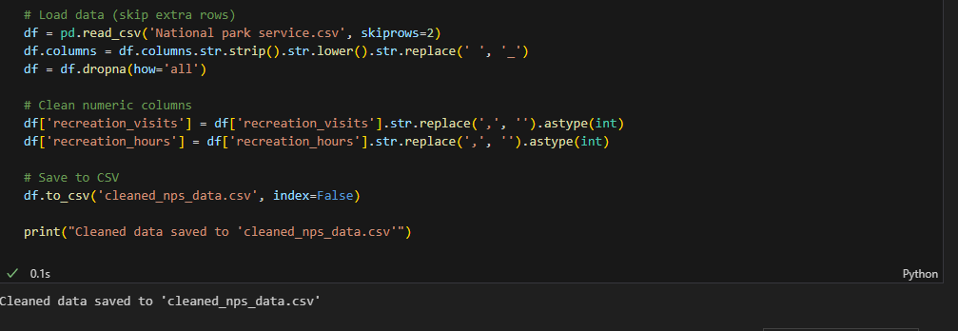
DATA Cleaning
The dataset used is the "NPS Public Use Statistics Query Builder" which contains monthly recreation visit data for various National Parks. Before analysis, the data was cleaned to handle missing values and convert columns to the correct data types.

Slide 9
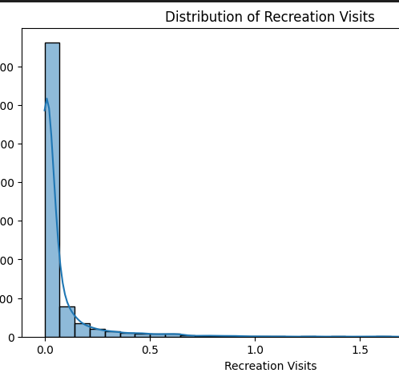
Exploratory Data Analysis
Exploratory Data Analysis (EDA) is conducted to gain a clear understanding of the dataset's structure, dimensions, and the nature of its variables and data types. It is essential for uncovering patterns, identifying distributions, and exploring relationships within the data. Additionally, EDA helps assess the overall quality and reliability of the dataset.

Slide 10
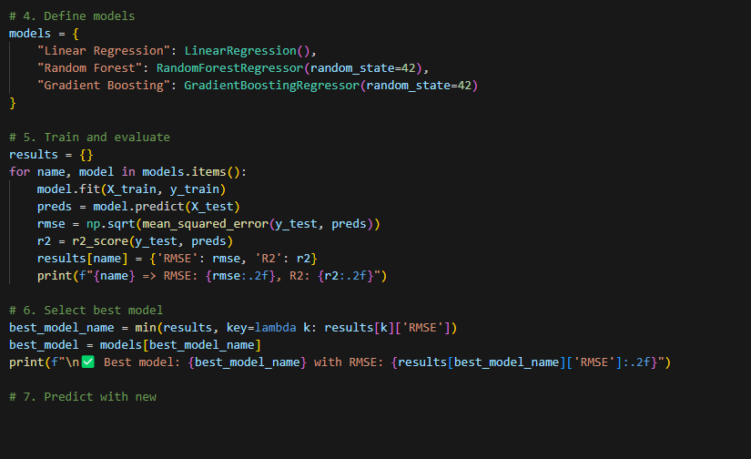
Model Training &Evaluation
Models Used:
Linear Regression
Random Forest Regressor (Best)
Gradient Boosting Regressor
Split: 80% Train / 20% Test
Metrics: RMSE, MAE, R²
Best Model: Random Forest
RMSE: 24,882.04
R²: 0.98

Slide 11
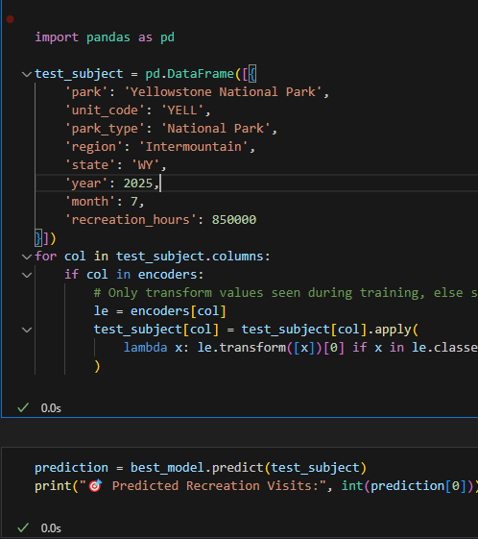
Best Model Insights
Based on the evaluation metrics, the Random Forest Regressor was selected as the best-performing model. To validate the model’s effectiveness, the top-performing algorithm—Random Forest Regressor—was applied to a new, hypothetical scenario to simulate a real-world forecast. Specifically, a projected visit to Yellowstone National Park in July 2025 was used as a test case to predict the expected number of recreation visits, as demonstrated below

Slide 12
ResulTs

Slide 13
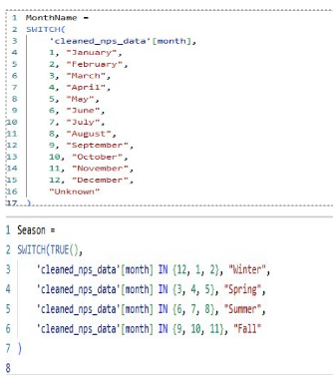
Dax Formulas
A DAX formula was implemented to create a month name column, simplifying the analysis by making time-based trends more interpretable. This was followed by the addition of a season column, allowing for a clearer examination of seasonal patterns and their impact on visitation trends.

Slide 14
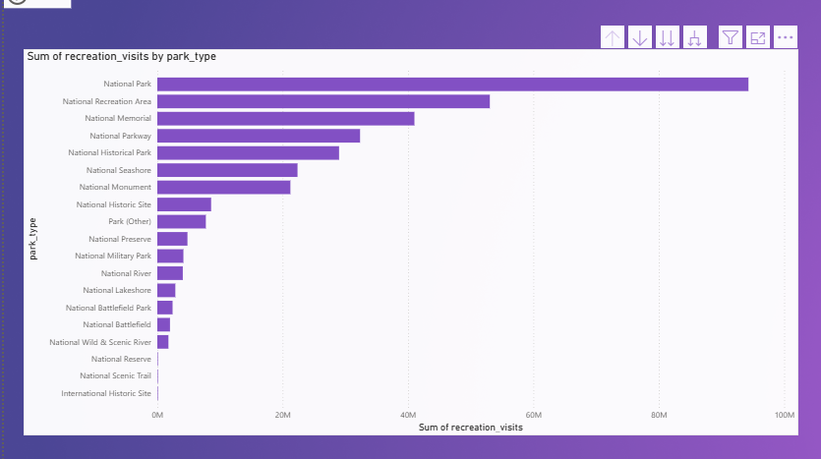
Site Popularity (Park Type)
The visualizations reveal a significant difference in visitor numbers across different park types. National Parks are by far the most popular. This indicates that the type of park is a critical factor in forecasting visitation.

Slide 15
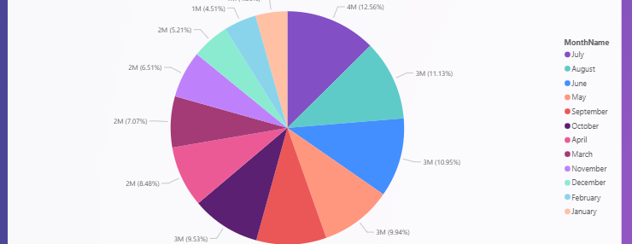

Months analysis
Furthermore the 'Sum of recreation_visits by Month Name' visualization with the National Historical Parks filter to only show National Historical Parks, further reinforces the importance of seasonality and specific holidays. The month of July has the largest percentage of visits, accounting for 4M (12.56%) of the total. This is a crucial insight that can be directly attributed to the 4th of July holiday. Many Americans visit historical sites during this period to celebrate national history, making it the peak month for this specific park type.

Slide 16
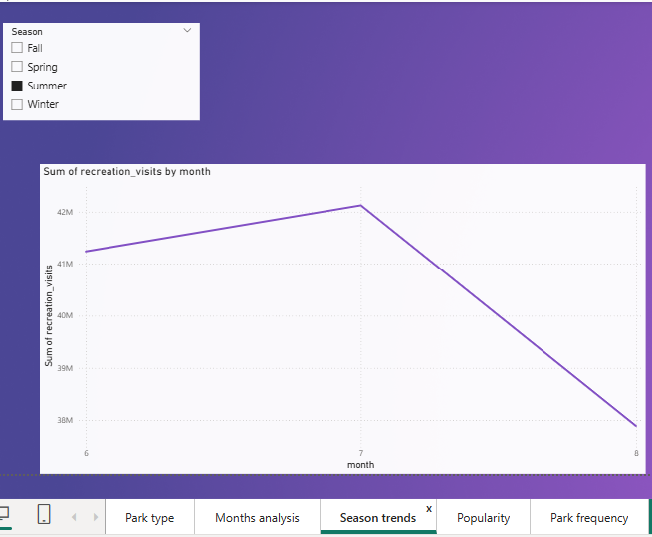
Seasonal Trends
The visualizations clearly show that visitation follows a strong seasonal pattern. Visitation consistently peaks during the summer months (June, July, August) and reaches its lowest points in the winter (December, January). This seasonality is a powerful predictor for the model.

Slide 17
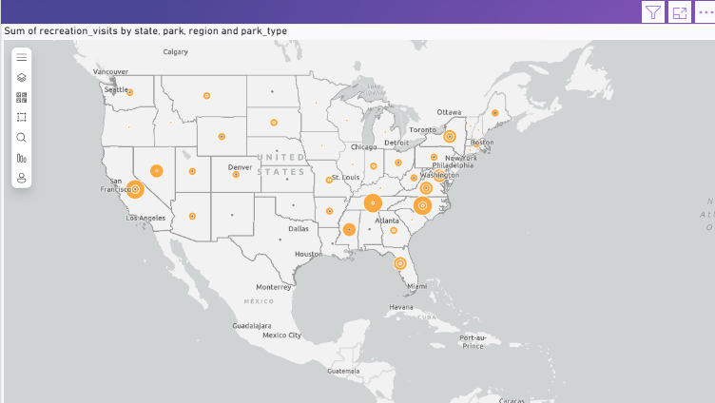
Geographical Popularity
By analyzing visits by State, it is evident that states with multiple iconic parks, such as Utah (Zion NP), California, and North Carolina, receive a disproportionately high number of visitors. This highlights the importance of location as a predictor.

Slide 18
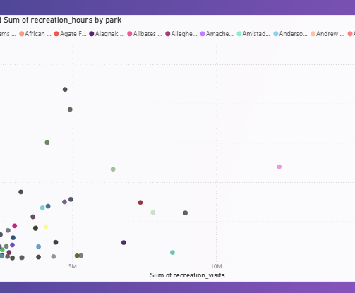
Correlation
There is a strong positive correlation between recreation_visits and recreation_hours. This indicates that when more people visit a park, they also tend to stay for longer periods. Shows if a park is visited frequently, and whether people stay longer or shorter.

Slide 19
RECOMMENDATIONS
Dynamic Staffing: Use the predictive model's forecasts to adjust staffing levels in real-time. During peak summer months (June, July, August), schedule additional staff for visitor centers, maintenance, and ranger patrols. Conversely, reduce staffing in off-peak months to optimize labor costs.
Inventory Management: Anticipate the demand for park passes, maps, and gift shop items by using historical data and forecasts. Ensure inventories are fully stocked before the summer surge and adjusted appropriately for the low-demand seasons.
Promote Off-Season Travel: Launch targeted marketing campaigns highlighting the unique benefits of visiting in the spring or fall. Emphasize activities like fall foliage hikes, winter wildlife viewing, or spring time wildflowers to attract visitors during traditionally slower months.

Slide 20

Future work
Integrate External Data Sources
Add weather, event, and holiday data to capture real-time factors influencing visitation.
Example: Rainfall might reduce visits; public holidays may cause spikes.
Park-Specific Predictive Models
Build individualized models for high-traffic parks like Yellowstone or Zion.
These models could account for park-specific trends and features (e.g., accessibility, capacity).
Real-Time Forecasting System
Automate the data pipeline to update predictions regularly (weekly/monthly).
Use APIs to fetch live data (e.g., Google Trends, traffic data).
ThePhoto by PhotoAuthor is licensed under CCYYSA.

Slide 21
Conclusion
The analysis effectively shows that a machine learning model—particularly the Random Forest Regressor—can reliably forecast recreation visits to U.S. National Parks using the available dataset. The model's strong performance metrics, along with its accurate prediction on a new hypothetical case, validate its dependability. This forecasting tool holds significant potential for supporting resource allocation and strategic planning efforts within the National Park system.

Slide 22
end

